Slide 1
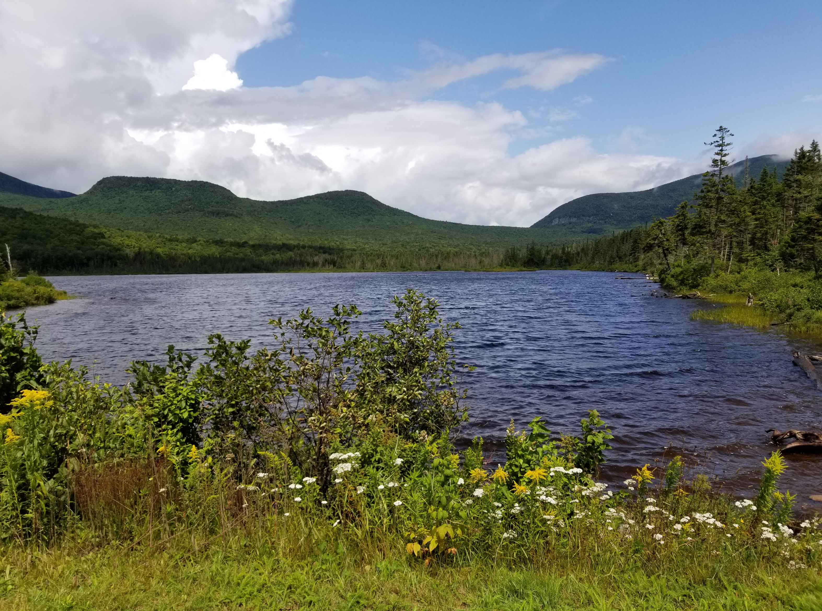
SEID Grantee and Local Development District Training 2022 www.nbrc.gov

Slide 2
Agenda
Staff Introductions- Andrea Smith
NBRC Overview- Andrea Smith
Award Process and Project Initiation- Andrea Smith
Overview of SEID Award Process- Andrea Smith
NEPA Review- Quin Mann
Role of Local Development Districts- Andrea Smith
Reimbursements- Molly Taflas

Slide 3
Agenda
7. Reporting requirements - Georgia Cassimatis
8. Procurement - Jon O’Rourke
9. Property - Jon O’Rourke
10. Project Oversight- Jon O’Rourke
11. Changes in a Project – Andrea Smith
12. Project Close-Out - Molly Taflas
13. Resources and Wrap-Up - Andrea Smith

Slide 4
Meet the NBRC Staff
Chris Saunders, Federal Co-Chair
Rich Grogan, Executive Director
Andrea Smith, Program Director
William Gallagher, Administrative Officer
Administrative Contracts, Accounting
Adrianne Harrison, Program Manager, IIJA
Marina Bowie, Program Manager, RFEP
USDA, Recreation Economy, Regional Forest Economy

Slide 5
Meet the NBRC Staff
Tom Sidor, Budget Analyst
Jon O’Rourke, Senior Program Specialist
Programmatic Monitoring, Amendments, Federal Regulation expertise
Molly Taflas, Senior Program Specialist
Reimbursements, Close-outs, De-obligations, Reporting
Sarah Lang, Program Specialist
Reimbursements, Close-outs, Reporting
Georgia Cassimatis, Program Specialist
Constant Contact, Website, Reporting
Quin Mann, the Clark Group, NEPA consultant

Slide 6
NBRC Overview

Slide 7
Mission and Authority
The mission of the Northern Border Regional Commission is to catalyze regional, collaborative and transformative community economic development approaches that alleviate economic distress and position the region for economic growth
The Commission was enacted by Congress through the 2008 Farm Bill which amended 40 US Code to include the creation of the NBRC
The statutory authority is based on one vote of the Federal Co-Chair and the collective votes of the four Governors
The NBRC was reauthorized in the 2014 Farm Bill and again in 2018

Slide 8
Commission Service Area
Only projects within NBRC’s service area are eligible for funding:
Maine: Androscoggin, Aroostook, Franklin, Hancock, Kennebec, Knox, Oxford, Penobscot, Piscataquis, Somerset, Waldo, and Washington
New Hampshire: Belknap, Carroll, Cheshire, Coös, Grafton, and Sullivan
New York: Cayuga, Clinton, Essex, Franklin, Fulton, Genesee, Greene, Hamilton, Herkimer, Jefferson, Lewis, Livingston, Madison, Montgomery, Niagara, Oneida, Orleans, Oswego, Rensselaer, St. Lawrence, Saratoga, Schenectady, Seneca, Sullivan, Warren, Washington, Wayne, and Yates counties.
Vermont: all counties within the State

Slide 9
Federal-State Partnership
The States play a crucial role in the NBRC as they partner with the Federal Government to focus NBRC funding strategies and prioritize investments.
The Commission: The decision-making process of the Commission is comprised of five voting members including a Federal Co-Chair, who is appointed by the President following confirmation by the Senate, and the Governors of Maine, New Hampshire, Vermont, and New York
Governor’s Alternates: The Governors are represented on the NBRC by their chosen alternate
State Program Managers: The Governor’s Alternates assign NBRC partnership duties to a State Program Manager. The SPMs serve as the primary point of contact for entities interested in NBRC funding

Slide 10
Investments Across the Region
In its thirteen-year history, the Commission has awarded over 300 grants amounting to more than $90 Million across the four states through its primary State Economic & Infrastructure Development (SEID) grant program and other special initiatives, including the Regional Forest Economy Partnership Program
NBRC currently has approximately 250 open grants

Slide 11
Eligibility Criteria
By statute (40 U.S.C. §15702), the NBRC is required to annually assess the level of economic and demographic distress in its service area. The resulting designations reflect whether the NBRC can provide grants within a county
Counties are designated per the categories below:
Distressed: Eligible for 80% funding and require a 20% match
Transitional: Eligible for 50% funding and require a 50% match
Attainment: Ineligible for funding, unless it is determined that a specific municipality within the county is distressed, or the project has a greater effect on distressed and transitional counties surrounding it
*the match requirement may differ from the above if a grantee submitted a COVID match waiver request at the time of their application submittal

Slide 12
Federal Funding Ceiling
If a project uses multiple federal sources, including the NBRC, no more than 80% of a total project cost can be comprised of federal funds
Loans and tax credits do not count toward the federal funding ceiling
It is equally important for applicants to check with other federal sources, as each federal agency may have its own restrictions.
For example, if an applicant receives $100,000 from another federal source, such as the Economic Development Administration, and the total project cost is $200,000, the total NBRC award could not exceed $60,000

Slide 13
Award Process and
Project Initiation

Slide 14
Award Process and Project Initiation
Step 1: Notice of Award
NBRC notifies all successful entities of their award, including the amount of the award by the end of August, with EDA and USDA projects typically announced in September
Once awards are made, NBRC works with grantees to submit any missing application support documents or documents that need to be corrected (i.e., revised project budget to reflect reduced award)
Notice of award is not approval to expend funds. A Notice to Proceed must be issued in order to expend any funds include matching funds

Slide 15
Award Process and Project Initiation
Step 2: Grant Agreement
Once all required application support documents have been obtained, NBRC issues Grant Agreements for projects. The grant agreement will contain among other things, the following:
The NBRC Grant Agreement Number: This number must be included in all documentation and emails that are sent to the States or NBRC offices. (e.g., NBRC21GNY01)
Contact information for both the grantee and NBRC
Please notify NBRC if this information changes, send changes to admin@nbrc.gov utilizing the Key Contacts Form (OMB#4040-0010)

Slide 16
Award Process and Project Initiation
Step 3: Obligation of Federal Funds
Once a Grant Agreement is executed, and NBRC is provided with the SF-3881 ACH Form (EFT), and the acknowledgement page of the NBRC Compliance Manual, obligation of federal funds can be requested
Having federal funds obligated does not allow a grantee to begin spending project funds
A grantee must have a Notice to Proceed in order to expend funds

Slide 17
Award Process and Project Initiation
Step 4: NEPA
NBRC will work with our environmental consultant to review NEPA intake forms to determine what level of NEPA review is needed
NBRC notifies grantee of what NEPA documentation needs to be completed and submitted.
If NEPA is being completed for another federal funder we may be able to adopt their findings
Depending on the level of environmental review, NEPA may be a longer process that can be completed in parallel to the granting gathering other required information to receive a Notice to Proceed

Slide 18
Award Process and Project Initiation
Step 4: LDD Contract and Securing Match/Cost Share
An executed LDD contract (if applicable) is part of the documentation required to be submitted to receive a Notice to Proceed
Documentation of committed match/cost share (NBRC Form 1002) together with letters of commitment from match/cost share choices must
Refer to the grant agreement and NBRC’s Grant Administration and Compliance Manual for additional guidance on the documentation needed to secure a Notice to Proceed

Slide 19
Award Process and Project Initiation
Step 5: Notice to Proceed
The Notice to Proceed is the official ‘ok’ to begin spending project funds
No reimbursements will be processed for work conducted prior to receiving a Notice to Proceed
No match/cost share will be counted that is expended prior to receiving a Notice to Proceed

Slide 20
Award Process and Project Initiation
Step 5 Continued: Notice to Proceed
The following items MUST be in place to receive a Notice to Proceed:
All match/cost share listed in the grant agreement must be committed (using NBRC Form 1002) listing committed match/cost share
LDD grant administration contract
SF3881 Automated Clearing House (ACH) Enrollment Form
NEPA review completed
*See compliance manual for other requirements for land, real property, equipment etc.

Slide 21
Key Terms
Period of Performance: this is the start and end date of the project to be completed for the grant agreement between grantee and NBRC. Please see your executed grant agreement for your project’s performance period. 2022 SEID awards will be October 1, 2022 – September 30, 2025
NBRC Grant Amount: The grant amount cannot be increased for any reason. Overruns on projects are the responsibility of the grantee
Required Match/Cost Share: This is the amount of other funds that must be documented during the project period

Slide 22
Key Terms
Indirect Cost Rate: This is the approved rate that has been agreed upon by the grantee and their Federal Cognizant Agency for indirect costs. All invoices must use this rate for their invoices when specific services as outlined are performed by the grantee. This is NOT a rate to be used by any subcontractor or consultant
Budget: Line items of expenditures. These line items may not be changed by the recipient without prior written approval by NBRC (2 CFR 200.308)
Grant Provisions: The laws and agreements that a grantee is required to follow as part of the contract with a federal awarding agency

Slide 23
SEID grant cycle flow chart
Phase 1
February/March
Federal Budget approved with appropriation for NBRC
Phase 2
May
NBRC hosts info sessions
May
Application portal open
Phase 3
September
New grantee/ LDD training
March
NBRC posts Letter of Interest and application information on website
March
NBRC hosts LOI info sessions
April
LOIs and waivers due
May
NBRC responds to LOIs, applicants invited to apply
June
Applications due
June/July
States review and score applications
August
Commissioners votes on State recommended projects
By end of August
NBRC notice of awards and unsuccessful applicants
Phase 4
August-October Grantees submit executed documentation to obligate federal funds
Pre-NTP
- Grantees complete NEPA process and document same to NBRC
Phase 5
Post-NTP Ongoing Work
- Grantees submit reimbursements
- Grantees submit quarterly reporting
- Grantees reach out to NBRC if they need budget modifications or changes in scope
- Grantee submit annual financial reports
- At the end of the grant grantee submit close out materials
- Grantees secure documentation necessary to receive a Notice to Proceed and submit same to NBRC
- NBRC issues a Notice to Proceed. From the date of the Notice to Proceed the grantee can commit and expend matching funds and NBRC funds

Slide 24
NATIONAL ENVIRONMENTAL POLICY ACT (NEPA)
Quin Mann, The Clark Group
(NBRC Environmental Consultant)

Slide 25
What is NEPA?
Enacted in 1970, the National Environmental Policy Act (NEPA) is a law that requires federal agencies to consider the environmental impacts of their actions and decisions before they act
NEPA does not require that the action with the least environmental impact is taken but that the consideration of potential environmental impacts be part of agency decision-making
Notes:
One of the key word here is before – this is why NEPA is a requirement before the notice to proceed is issued.
40 CFR 1506.1: No action can take place that would have an adverse environmental impact or limit the choice of reasonable alternatives (irretrievable commitment of funds)
This does not preclude design, development, and engineering activities
For the purpose of NEPA, the human environment is defined broadly. NEPA considers impacts like impacts to vegetation and wildlife but also considers things like impacts to historic resources and noise.
NEPA is what is referred to as an “umbrella” statute. Other federal environmental requirements may be identified as part of going through the NEPA process, including but not limited to requirements around floodplain, wetlands, endangered species, and historic preservation.
As noted earlier, the level of review depends on the scope of a proposed action

Slide 26
NBRC’s NEPA Processes
Applicant completes NEPA Intake Form at the time of application
NBRC determines the appropriate level of NEPA analysis
NBRC identifies an alternative “lead” federal agency for the NEPA process
Applicant completes NEPA analysis
NBRC prepares documentation to adopt another federal agency’s NEPA determination*
NBRC approves NEPA analysis*
The NEPA process is complete
*A public comment period may be required after this step
Notes:
The process shown here is very high level
NBRC must review and approve all analysis and NEPA documents, including public notices

Slide 27
Levels of NEPA analysis
Categorical Exclusion (CATEX): A category of actions that is predetermined to not individually or cumulatively have a significant effect on the human environment (i.e., planning only, workforce training programs)
Environmental Assessment (EA): Prepared when an action may or may not cause significant impacts
Environmental Impact Statement (EIS): Prepared when an action is expected to cause a significant impact on the human environment
Notes:
All federal agencies have different categories of activities that qualify for these different levels of analysis.
A CATEX is not a waiver or exemption from NEPA, but a means of complying.
EISs are rare, typically a project will trigger a CATEX or an EA

Slide 28
Levels of NEPA analysis
Categorical Exclusion (CATEX)
Typically for renovation and non-construction activities
Brief review, no public comment period unless another federal requirement is triggered
Environmental Assessments (EAs)
Typically for new construction activities
More robust review typically ranging from 6 – 12+ months, includes a 30-day public comment period

Slide 29
NEPA Resources
NBRC Staff/The Clark Group
Local Development Districts
Some LDD partners are familiar with completing NEPA (whether or a prior NBRC award or through other federal funders). If an LDD can assist a grantee with completion of NEPA, this is an eligible NBRC cost and is separate from the 2% grant administration allowance. If a grantee needs assistance with completing NEPA and access to NBRC grant funds to complete NEPA, they should contact NBRC directly.

Slide 30
NEPA Resources
Contractors
In some instances, it may make sense for an applicant to work with a contractor with NEPA experience to support the development of NEPA documents.
State Historic Preservation Offices
Contact information for these offices is provided within NBRC’s Grant Administration and Compliance Manual, which can be viewed and downloaded from NBRC’s website www.nbrc.gov/content/administration

Slide 31
LOCAL DEVELOPMENT DISTRICTS (LDDs)

Slide 32
What is a Local Development District?
40 USC Subtitle V: Regional Economic and Infrastructure Development, the term Local Development District is defined by 40 USC §15101
In summary, an economic development district is an entity located in the region, and operated in a manner that ensures broad-based community participation and an effective opportunity for local officials, community leaders, and the public to contribute to the development and implementation of programs in the region.
LDDS are either an already existing federally designated Economic Development district, as certified by the US Economic Development Administration (EDA), or an organization similar in nature to a regional planning and/or regional development commission.
40 USC §15303 directs the Commission to enhance the capacity of, and provide support for, local development districts in its region and where no local development district exists, foster the creation of a local development district.
NBRC meets the spirit of federal code by requiring projects funded our SEID program to utilize a LDD for grant administration unless the entity is an agency of State Government or has applied for and received waiver approval of this requirement.

Slide 33
Role of Local Development Districts
The NBRC is aided by a group of regional organizations called Local Development Districts (LDDs) that assist the NBRC in its outreach activities and assist grantees in administering their grants
All grantees are required to contract with an LDD unless they are a state agency or have been granted an LDD waiver from the Northern Border Regional Commission prior to the submission of the EID application
A copy of the executed grant administration contract for services must be provided to NBRC as part of the documentation necessary to receive a Notice to Proceed

Slide 34
Scope of LDD Contracts
Grantees and LDDs should discuss their project administration needs and include them within the contract which outlines the intended scope of service. The amount of the LDD contract must align with the costs for grant administration included in the project’s budget (SF424cbw)
Grant Administration contracts typically consist of the following:
General Assistance: General knowledge base about federal grant programs, specifically NBRC. Provide guidance to the grantee with respect to documentation needed for obligation of federal funds, resources to complete (NEPA), and Notice to Proceed requirements. During the project, responsibilities may include guidance on procurement of goods and services and contractors, reimbursements, reporting, and documentation required to amend a project.

Slide 35
Scope of LDD Contracts
Quarterly Progress Reporting: Ensure that the grantee prepares and submits all quarterly reports (SF-PPR) on time. Quarterly reports must be filed from the start of the project’s performance period through project close out. For 2022 SEID projects the performance period begins October 1, 2022.
Reimbursement Requests: Provide guidance to grantees on filing reimbursement requests (SF270) and review reimbursement requests for accuracy, within approved budget and contain all the necessary documentation to provide evidence of match and reimbursements that are expected to be paid by NBRC

Slide 36
Scope of LDD Contracts
Annual Financial Reporting: Ensure that the grantee prepares and submits all required annual reports (SF425) on time. Annual reports cover the federal fiscal year (October 1-September 30) and are due by October 30th. For 2022 SEID projects the first annual financial report to be filed will be for the period October 1, 2022-September 30, 2023, and due by October 30, 2022
Close Out/Final Reporting: Provide oversight to the grantee in submitting all required close out documentation in a timely manner after the project is complete. Assists the grantee with establishing a process to meet the reporting requirement at three years after grant close out (GPRA)

Slide 37
Outside the Scope of LDD Contracts
The 2% LDD grant administration allowance does not cover costs related to conducting bid processes, assessing bid documents for completion, interviewing potential consultants, revise programmatic budgets, or perform additional services beyond those reflected in the grant administration contract
While the LDD may have the expertise and personnel to provide those services, they are outside the intended scope of the LDD grant administration allowance

Slide 38
Outside the Scope of LDD Contracts
If a grantee wishes to engage the LDD in additional work outside their Grant Administration contract, such as to have the LDD be the Project Manager, they may enter a separate Grant Management contract with the LDD
If the intent is to use NBRC funds or count those costs as match/cost share, they must be included within the project budget (SF424cbw) on file with NBRC

Slide 39
LDD Compensation
LDDs are reimbursed based on the amount of work performed
LDDs invoice the grantee, the grantee pays the invoice, and then submits reimbursement of those costs to NBRC in their reimbursements
LDDs are compensated for their grant administration fees based on the formula of 2% of the NBRC grant award
This amount must be reflected in the grantee’s project budget (SF424cbw)

Slide 40
LDD Compensation
LDD invoices should reflect detailed information (date of service, time, brief description of work performed and total amount of invoice. NBRC also recommends the invoice carry existing balance information, so grantees are kept apprised of remaining funds available on the contract, as the 2% cap on grant administration is the maximum allowed
The LDD will invoice the grantee for their services to be included in the Request for Payment- no lump sum payments
The LDD’s indirect cost rate (as determined by their Federal Cognizant Agency) may be added to salary and fringe and LDDs should make grantees aware of this when discussing the scope of service contract.

Slide 41
Questions?

Slide 42
Reimbursement Process

Slide 43
Reimbursement Process
Requests for reimbursement are required to be made using the SF-270 “Request for Advancement or Reimbursement” form
All reimbursement requests should be emailed to admin@nbrc.gov with your NBRC grant # in the subject line of the email
* For a guide to completing the SF-270 please refer to the compliance manual

Slide 44
Reimbursement Process
Once NBRC receives the request it will be processed in the order in which it was received
A staff member will follow up with the grantee if necessary. If there are no issues, the request will be forwarded on for the payment to be electronically transferred to the grantee’s bank account using the ACH information provided
When the request is processed, the grantee will receive an email acknowledging the request
After receiving this email the grantee can expect to receive payment within 10 business days

Slide 45
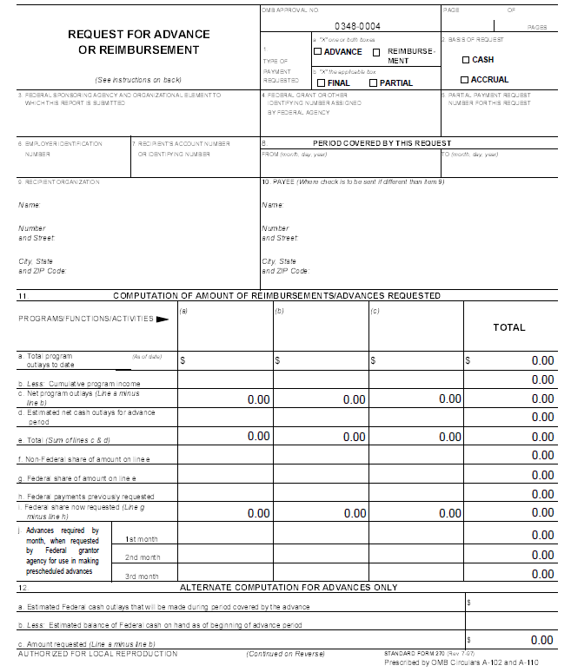
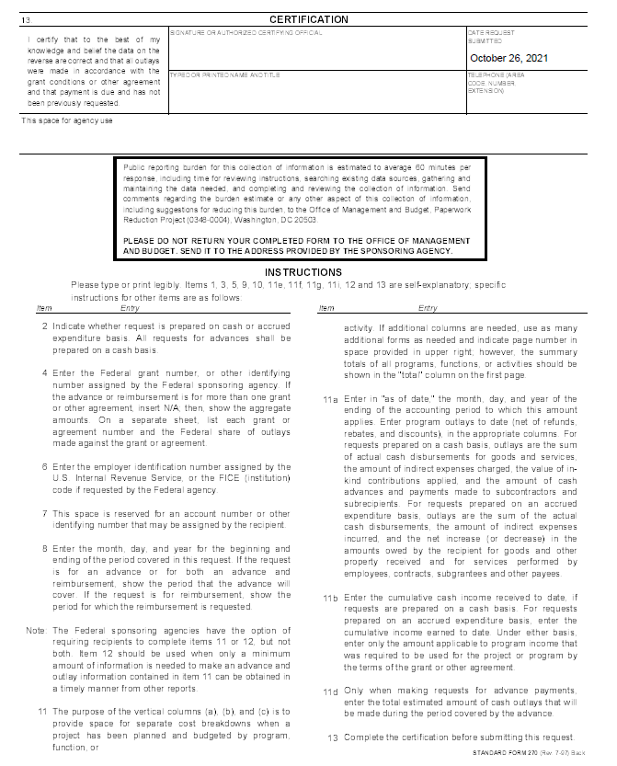
Reimbursements

Slide 46
Documentation for Reimbursements
Supporting documentation for requested NBRC funds and expended match are required to be submitted with the SF-270
Documentation includes anything that is necessary to demonstrate that funds were spent, costs were incurred, and work was completed
Examples of documentation:
Receipts for purchase of goods and supplies
Payroll records for staff time
Invoices from selected contractors and/or purchases
NOTE: The documentation to demonstrate work completed should not be created for the express purpose of meeting any NBRC requirements

Slide 47
Timing of Reimbursements
Grantees (except USDA) may submit requests for reimbursement on their own schedule following these basic rules:
All time periods from the start of the project to close-out must be accounted for and not overlap
NBRC will not process more than one request for any specific time period
No time periods should be skipped
Reimbursements should reflect whole months
All projects should be able to pay their bills within a month of receiving them without anticipating that NBRC will cover costs immediately

Slide 48
Reporting

Slide 49
Quarterly Reporting (SF-PPR)
Quarterly Reports for projects are due to NBRC October 1st of award year through project close out.
SF-PPR’s are due after awards have been announced, regardless of the work completed and they are a requirement to keep your award in compliance
SF-PPR’s should be emailed to admin@nbrc.gov with your NBRC grant # in the subject line of the email
SF-PPR can be found in the appendix of the compliance manual and at the end of this PP, on our website and in the compliance manual

Slide 50
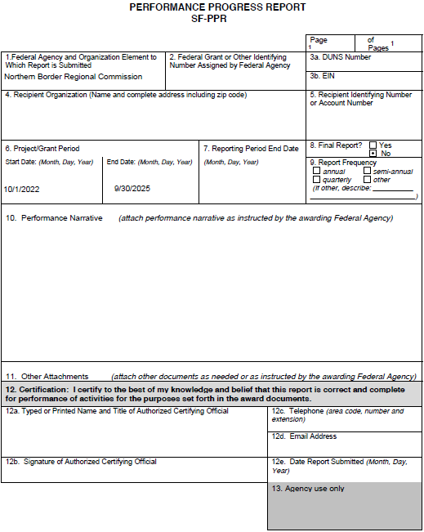
Reporting deadlines
Q 1 | October 1-December 31 | Due January 30
Q 2 | January 1- March 31 | Due April 30
Q 3 | April 1- June 30 | Due July 30
Q 4 | July 1- September 30 | Due October 30
* A fillable SF-PPR can be found here, compliance manual, on our website and at the end of this PP

Slide 51
Yearly Reporting (SF-425)
Financial reports are not reimbursement requests. They are reports on the financial status of the project using the SF-425
These reports are due annually and at project close-out. For all NBRC grantees, the financial report is due on October 31st for each federal fiscal year (October 1 to September 30) and 45 days after the close of the project
Even if no reimbursements have been made in the fiscal year, this form is still required
SF-425’s should be emailed to admin@nbrc.gov with your NBRC grant # in the subject line of the email
* For a guide to completing the SF-425 please refer to the compliance manual

Slide 52
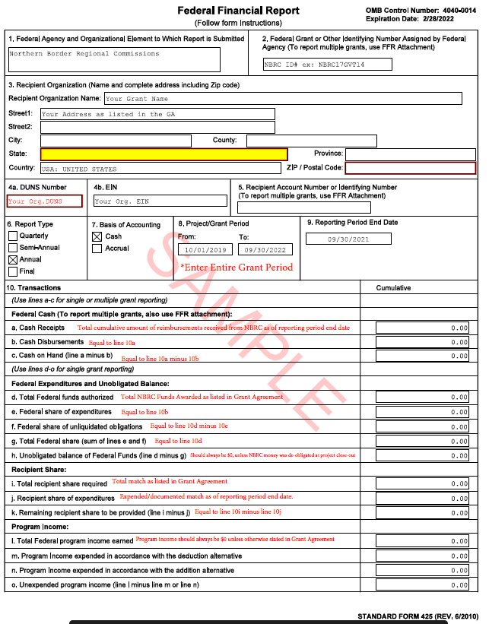
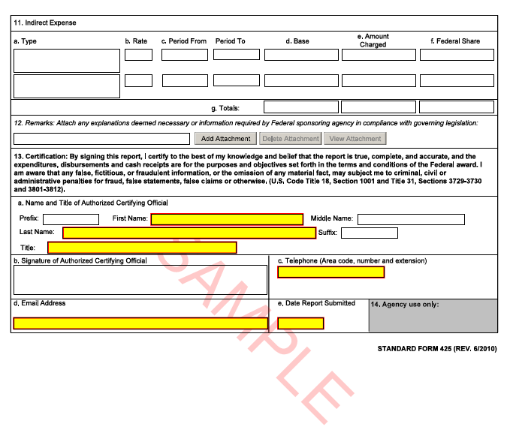
SF-425

Slide 53
Procurement / Property / Project Oversight
Up next…
2 CFR 200 – Code of Federal Regulations
Full and open competition
Property & Equipment
Records, Monitoring & Compliance
NBRC.gov – “Resources”

Slide 54
2 CFR 200 – Code of Federal Regulations
Procurement actions involve the purchase of goods and services needed to support the grant award. Government-wide regulations contained in 2 CFR 200 317-326 govern procurement actions
These regulations allow grantees to follow their own procurement procedures so long as they meet the minimum standards identified within 2 CFR 200
It is the responsibility of the grantee to review and understand these applicable procurement requirements
Make sure you have your Notice to Proceed (NTP) in place before committing any funds

Slide 55
Full and Open Competition
All procurement transactions must be conducted in a manner providing full and open competition consistent with the standards of 2 CFR 200.319. To ensure objective contractor performance and eliminate unfair competitive advantage
Grantees must ensure that all solicitations (invitations for bids/quotes and requests for proposals) contain a clear and accurate description of the product or service being procured, identify all requirements that the offeror must fulfill, and all factors that will be used in evaluating bids or proposals
The grantee must ensure that all prequalified lists of persons, firms, or products used in acquiring goods and services are current and include enough qualified sources to ensure maximum open and free competition

Slide 56
Made in America
In accordance with the policy of the United States Government, consistent with applicable law, use, terms and conditions of Federal financial assistance awards and federal procurements, recipients must maximize the use of goods, products, and materials produced in, and services offered, in the United States.
Whenever possible, the recipient shall procure goods, products, materials, and services from sources that will help American businesses compete in strategic industries and help America’s workers thrive.
See the January 25, 2021 Executive Order on Ensuring the Future is Made in All of America by All of America’s Workers for more information.
The Build America Buy America Act, enacted as part of the Infrastructure Investment and Jobs Act on November 15, 2021, established a domestic content procurement preference for all Federal financial assistance obligated for infrastructure projects after May 14, 2022.
The U.S. Department of Commerce is working with the Made in America Office to coordinate compliance with these procurement requirements

Slide 57
Typical methods of purchasing
Micro-purchases
Purchases by micro-purchase is the acquisition of suppliers or services when the aggregate dollar value of the transaction does not exceed $10,000 (pursuant to OMB Memorandum 18-18, 6/20/2018).
Small Purchase Procedures
Purchases under this procedure involve solicitation of an adequate number of qualified sources when the size of the transaction is not expected to exceed the federal government’s “simplified acquisitions threshold” (currently $250,000).
Competitive Sealed Bids
Through this procedure, bids publicly solicited through formal advertising and a firm fixed price contract is awarded to the lowest responsive and responsible bidder. This is the preferred method for construction, generally referred to as a Request for Proposal (RFP).
Competitive Proposals
Procurement by competitive qualifications, typically referred to as a Request for Qualifications (RFQ). The method, where price is not used as a selection factor, can only be used in procurement of A/E professional services (§ 200.321).

Slide 58
Property Basics
Property
Title to supplies, equipment, and real property acquired under a grant vest with the grantee that purchased it. However, NBRC retains a residual financial interest in grant acquired property under certain circumstances
Types of Property
Federal regulations contained in 2 CFR 200 address the treatment of real property, equipment, supplies, and intangible property (such as copyrights and patents) purchased with grant funds. However, because of the activities financed by NBRC grants, most of its grantees will deal primarily with equipment and real property
Equipment
Real Property
Equipment is defined as items of tangible property having a useful life of more than one year and a unit acquisition cost exceeding $5,000.
Real property means land, including land improvements, structures, and appurtenances thereto, but excludes movable machinery and equipment.

Slide 59
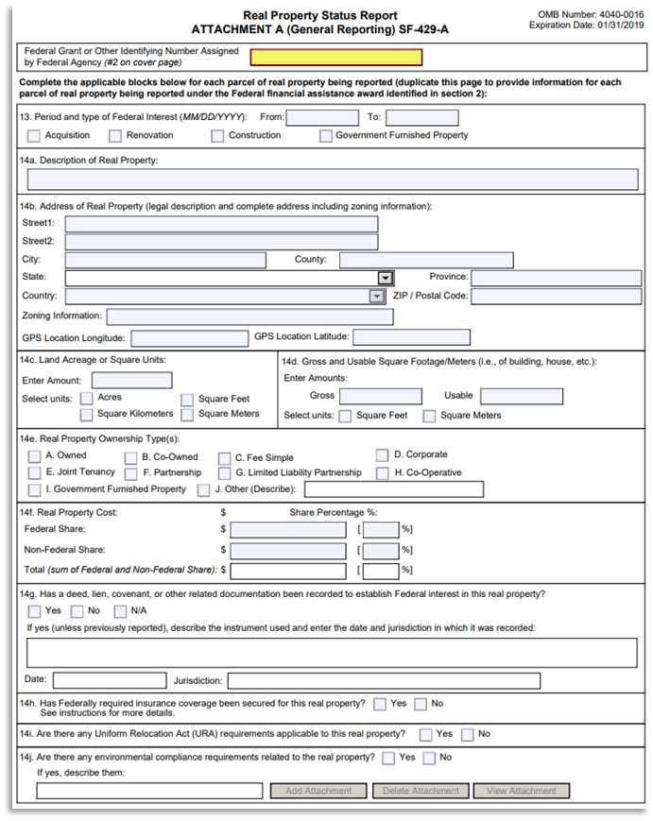
Real Property Forms
NFI (Notice of Federal interest)
20-year Federal vested interest
NFI recorded to deed
SF-429-A
Report yearly inventory status updates

Slide 60
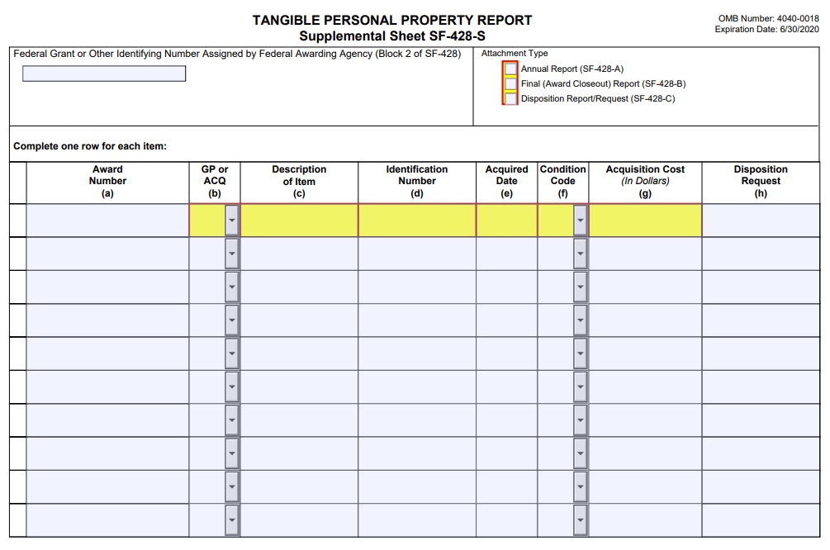
Equipment Forms
Over $5,000
Considered equipment, Example – Excavator
$5,000 and under
Considered supplies
Example – personal computers
Other considerations
At close-out submit schedule of depreciating values
Shall retain equipment until value falls below $5,000
Equipment inventory every 2 years using SF-428-S

Slide 61
Project Oversight
NBRC seeks to exercise responsible stewardship of Federal Funds in a manner that is transparent and accountable to the public
Grantees are responsible for managing federal funds in compliance with applicable laws, regulations and the terms and conditions of their NBRC grant agreement

Slide 62
Record Retention
Monitoring
And Site Visits
Compliance
Financial records, supporting documentation, statistical records, and all other grantee records pertinent to the NBRC grant award must be retained for a period of three years following submission of the final expenditure report on that award.
The rights of access include
timely and reasonable access to the grantee’s personnel and contractors for the purpose of interview and
discussion related to the records
If NBRC determines that noncompliance is material in its nature or degree, or that work performed under the grant is substandard or performed in any way that violates federal, state, or local law, NBRC may undertake enforcement actions consistent with the requirements of 2 CFR 200.207 and 2 CRF 200.339.
A Grantee may appeal any finding of noncompliance and resulting enforcement action.
Monitoring by NBRC involves the continuous collection or relevant information about the performance and administration of grantees.
Monitoring can be conducted using a variety of techniques including routine communication with grantees, desk review of submitted information and required reports, and site visits.

Slide 63
Procurement / Property / Project Oversight
Summary:
2 CFR 200 – Code of Federal Regulations
Full and open competition
Property & Equipment
Records, Monitoring & Compliance
NBRC.gov – “Resources”
Make sure you have your Notice to Proceed (NTP) in place before committing any funds!

Slide 64
Changes to a Project

Slide 65
Changes to a Project
The approved grant agreement and budget establishes the planned parameters of award performance
Modifications to a project may include extensions to the period of performance, changes to the scope of a project, and budget adjustments
Grantees should not move forward with any project changes without first receiving NBRC review and approval- Such actions may trigger enforcement measures authorized by 2 CFR 200.207 or 2 CFR 200.208

Slide 66
Changing Performance Period
If a project cannot be completed within the approved period of performance, an extension of time may be requested
Requests should be made prior to the end of Period of Performance listed in the grant agreement and be sent to admin@nbrc.gov
If the grant agreement is expired no funds can be reimbursed
Requests for extension should include the proposed revision to Period of Performance, the reason for the extension and a revised project timeline

Slide 67
Changing Performance Period
Grantees should confirm the scope, budget and match for the project remain unchanged
If the scope, budget, or match will be changing, documentation to support those changes must also be provided
If an extension is not approved, or if more than one extension is granted, and the grantee is unable to complete the project within the timeframe outlined, the grantee risks being excluded from applying for future investment grant rounds

Slide 68
Changing Budget
No increases to the NBRC award will be made
Any cost overruns are the responsibility of the grantee
Cumulative transfers between direct cost categories (line items) in your budget are allowed up to 10% in accordance with 2 CFR 200.308
Budget changes that involve changing the scope of work or objectives (regardless of the grant amount) require NBRC prior approval

Slide 69
Changing Budget
To request a budget modification, submit the revised budget (SF424cbw) and a narrative justification to admin@nbrc.gov and a copy of the e-mail to the local development district providing grant administration assistance on the project
Grantees are cautioned against moving forward without prior approval of changes from NBRC. Such action may trigger enforcement steps by NBRC, such as those permitted under 2 CFR 200.208 (imposition of special conditions), and 2 CFR 200.340 (suspension or termination of award)

Slide 70
Changing Scope
The grant agreement establishes the scope of the project
Projects should be implemented in a timely manner and within the approved scope of work that the funds were intended to support
When circumstances arise that interfere with the grantee fulfilling the approved scope, a change in scope may be requested
This is a formal process under which the grantee must submit a narrative detailing the proposed scope change and any associated budget modifications, together with confirmation the identified match on the project remains in place

Slide 71
Changing Scope
If the timeline of the project will be changing as result of the scope change, a revised timeline must also be provided
The narrative must explain the rationale for adding, modifying, or deleting an activity and explain how such revisions will affect the expected outcomes of the project
The request and documentation supporting the request must be sent to admin@nbrc.gov with a copy to the local development district
Amendment requests are processed in the order they are received NBRC strongly recommends projects communicate with their LDD regarding project changes and review the NBRC compliance manual regarding the documentation necessary to process a project change

Slide 72
Changing Scope
De-obligations are processed by NBRC when a project doesn’t go forward, or a project is completed and does not utilize its entire NBRC award
At close-out, if a grantee is not utilizing their entire grant award, they must provide NBRC written confirmation of their intention to have the remaining funds de-obligated
Once a de-obligation is processed, the unused funds are added to the State’s SEID allocation in the following grant year

Slide 73
Project Close-Out

Slide 74
Project Close-out
Close-out documents are required to be emailed to NBRC within 45 days after completion of the project. There are five items that are required for project close-out:
1. Final request for reimbursement: Using the SF-270 along with supporting documentation (if all funds are not going to be used for the project, a letter requesting that the remainder (include exact dollar amount) be de-obligated from the project is required)
2. Final Financial Report: Using the SF-425

Slide 75
Project Close-out
3. Final Report: A final report should provide a narrative of the entire project, from inception to completion using the Performance Progress Report (SF-PPR)
4. GPRA Form: The Government Performance and Results Act
5. Project Photos: Three to five photos of the completed project
5% of the total NBRC award will be held until all project close-out documents are received by NBRC

Slide 76
Government Performance & Results Act
The Government Performance and Results Act (GPRA) is a United States law enacted in 1993 & is one of a series of laws designed to improve government performance management
The GPRA requires agencies to engage in performance management tasks such as setting goals, measuring results, and reporting their progress
Your submitted application outlines the performance measures that you determined were applicable to your project
These performance measures will be reported to NBRC at the close of the project and again 3 years later

Slide 77
Final Questions?

Slide 78
Resources
NBRC website – www.nbrc.gov
NBRC Grant Administration and Compliance Manual available to view and download from www.nbrc.gov/content/administration
2 CFR Part 200 – Requirements for Federal Awards
40 USC Subtitle V. Regional Economic and Infrastructure Development
State Program Manager –ME, NH, VT, NY
Your Local Development District
SF-270
SF-PPR
SF-425

