Slide 1

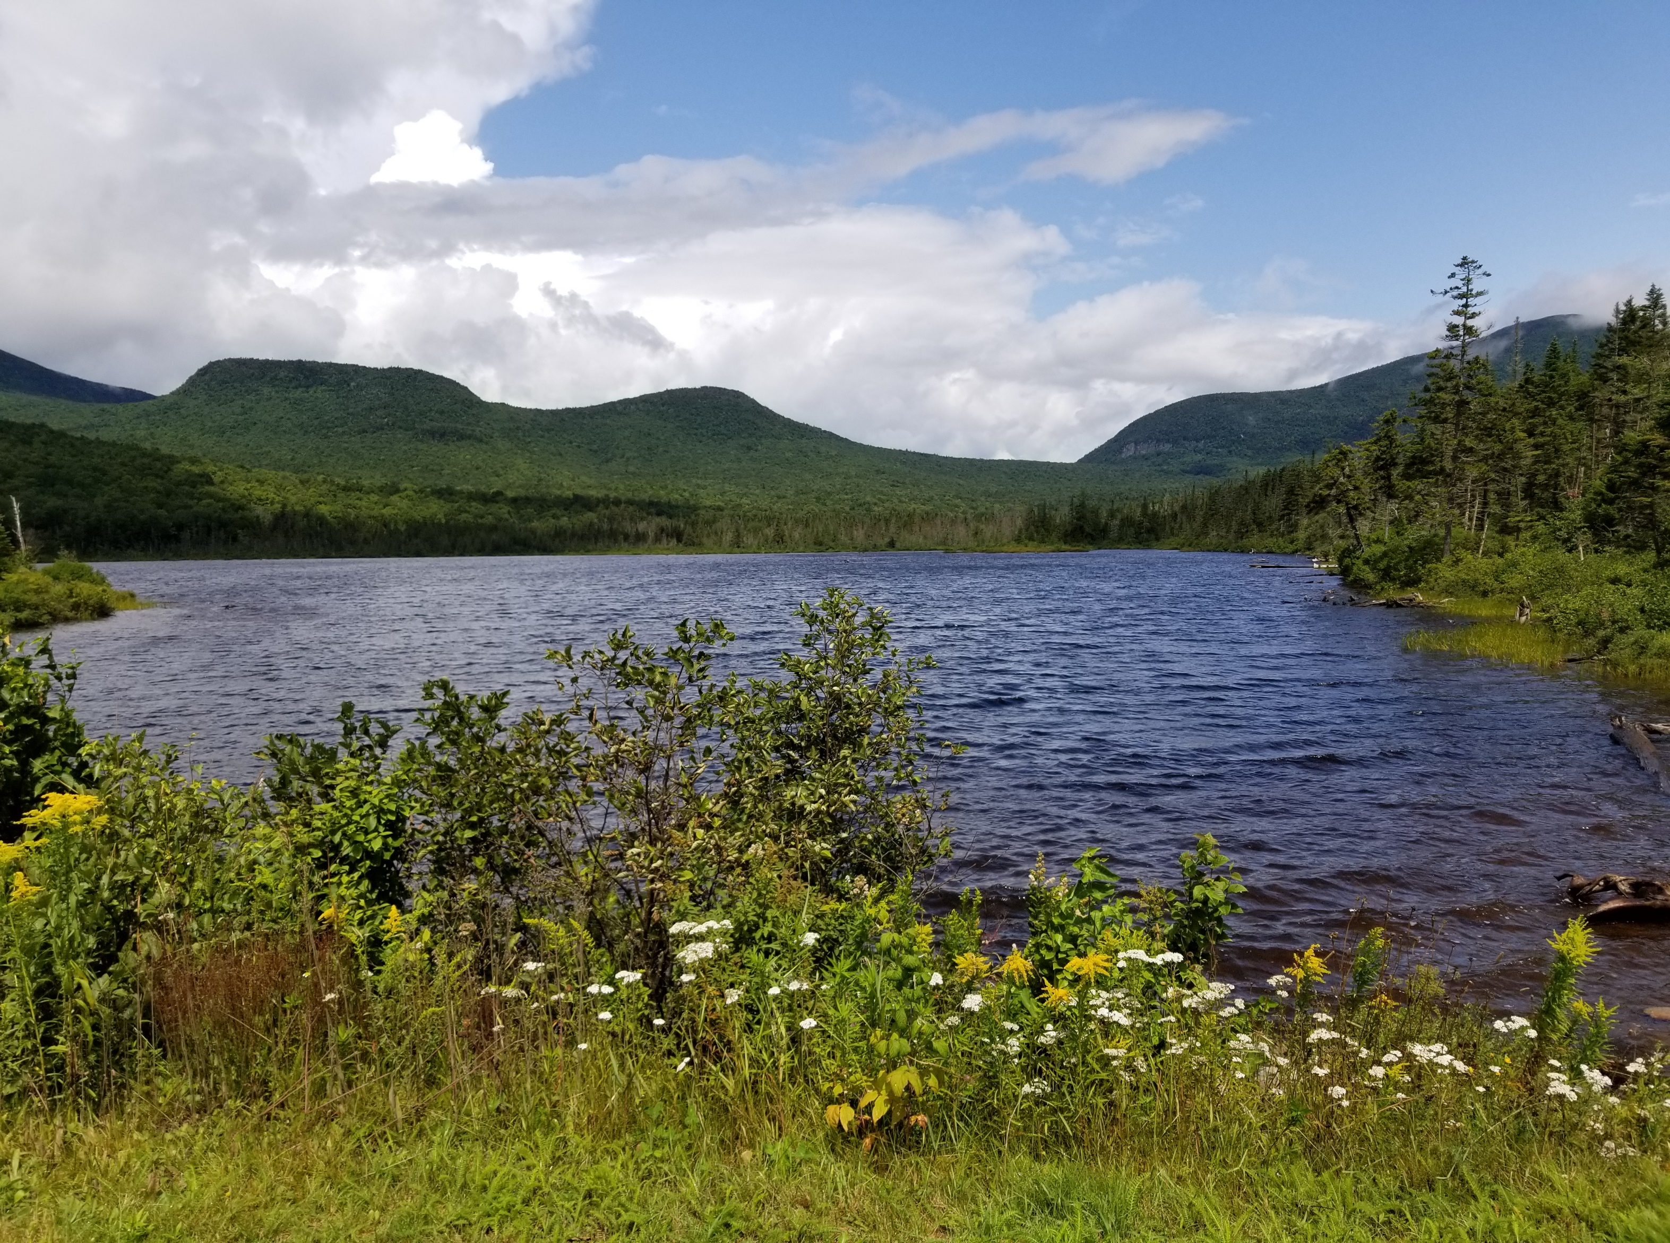
www.nbrc.gov
2026 SUPPORT FOR NEW GRANTEES
Brief Next Steps for New Grantees
Updated June 2026

Slide 2
AWARD NOTIFICATIONS
NBRC notifies all successful entities with an award notification AND an award letter.
Award notification generated by the GMS indicates successful application
Award letter sent as email to Authorized Official, Project Contact and LDD if applicable. To find your Award Letter:
  Navigate to Application Record (AP-NBRC-###) in the GMS to view "Collab" tab
  Emailed copy of the award letter should appear in the Messages section.
  Download your award letter for your files
Award letter is NOT a Notice to Proceed. NTP or Partial NTP is required before spending or committing award funds AND match and cost share funds.

Slide 3
AWARD LETTER
Important Information in Your Award Letter:
Award amount
Required actions
  Confirm UEI # and SAM.gov expiration date in organization profile
  Download New Grantee Toolkit
  If applicable, complete revisions
Award acknowledgement statement
Deadlines for Required Actions
Negotiation Office Hours
Dates for New Grantee Training Sessions

Slide 4
ACTION - Register for New Grantee Training Once Scheduled
See NBRC's Events webpage for date and registration link
Session 1 – Welcome & Next Steps
This is a mandatory live session
Recommended Action: View on-demand training sessions and materials
Session 2 – Grant Agreements, LDD Contracts, NEPA Process & Partial NTPs
Session 3 – NEPA
Session 4 – BABAA
Session 5 – Reimbursements & Reporting
Session 6 – Amendments & Closeout

Slide 5
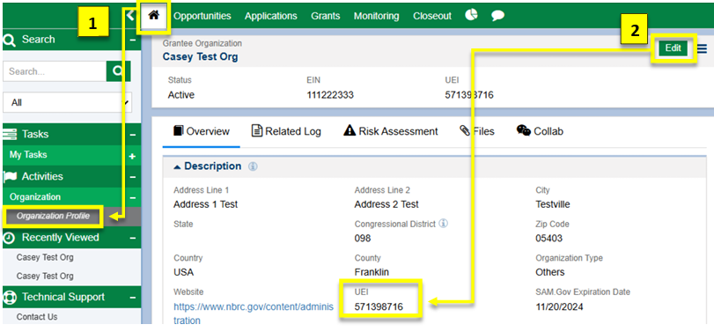
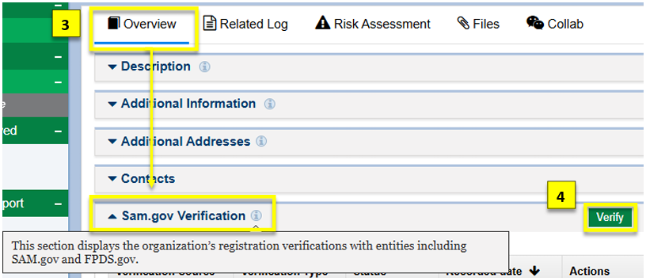
ACTION – Confirm UEI and SAM.gov
Locate Organization Profile in GMS
Download and use the Managing Organization Account and Contacts resource to complete this action
Review and confirm UEI #
Review SAM.gov expiration date
  If expired, use "Verify" function
  If current, no action needed
UEI and SAM.gov must be correct for obligation of funds.
Notes:
Additional resources are available to assist in completing this task – linked here.

Slide 6
ACTION – Find and Complete Revisions
Locate and Review Revisions
If applicable, requested revisions to the application materials will be outlined in a separate email notification, sent to AO
Navigate to Collab tab and view message titled "NBRC Required Revisions"
Download and use the GMS Grantee Toolkit to complete revisions.
Attend Negotiation Office Hours
Attend New Grantee Training Sessions
Submit revisions or negotiations by the date indicated in the award notification.

Slide 7
REMINDERS
Wait for your Notice to Proceed to spend or commit project funds. At this stage in the award process, project funds including award funds, match and cost share funds are not available to spend or commit. Project costs committed or expended without authorization from NBRC will be deemed ineligible.
If you can't meet the requested timelines for required actions and information, please communicate to NBRC. Failure to respond by this date or notify NBRC of the need for additional time to complete this step may result in the award being rescinded.
Contact NBRC through the Collab tab email function in the Application file. Please always include your project name and grant award number in the subject line

Slide 8
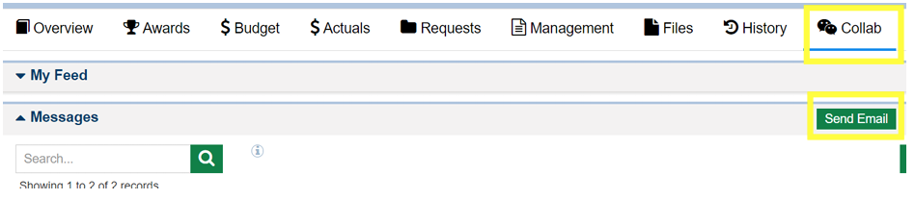
USING THE COLLAB TAB
Please DO NOT use the “My Feed” feature. NBRC is not notified.
Send messages by navigating to the Collab Tab → Messages → “Send Email” to admin@nbrc.gov
Include grantee organization and Application ID (AP-NBRC-###) in subject line
See the GMS Grantee Toolkit section 1.5 “Using the Collab Tab”

Slide 9
GRANTEE RESOURCES
Support for New Grantees
GMS Grantee Toolkit
Locating records
Uploading files and Completing revisions
Using the Collab tab for communication with NBRC
Support on next award phases including grant agreements
Grant Administration Compliance Manual
Details on award process and project initiation activities
Next award phases including grant agreements and notice to proceeds
Guidance on procurement, reporting, reimbursements, and more...
www.nbrc.gov/content/administration

Slide 10
GRANTEE RESOURCES
Forms & Guidance
Visit the Support for New Grantees Resource page of NBRC’s website
Visit the Events page for upcoming trainings schedule
NBRC Resources page contains many forms
Notes:
Use your LDD!

Slide 11
GRANTEE RESOURCES
Human Support
NBRC Staff – Please use the Collab Tab of the GMS application record for NBRC staff support
Your Local Development District
Please always include your project name and grant award number in the subject line
Notes:
Use your LDD!

