Slide 1

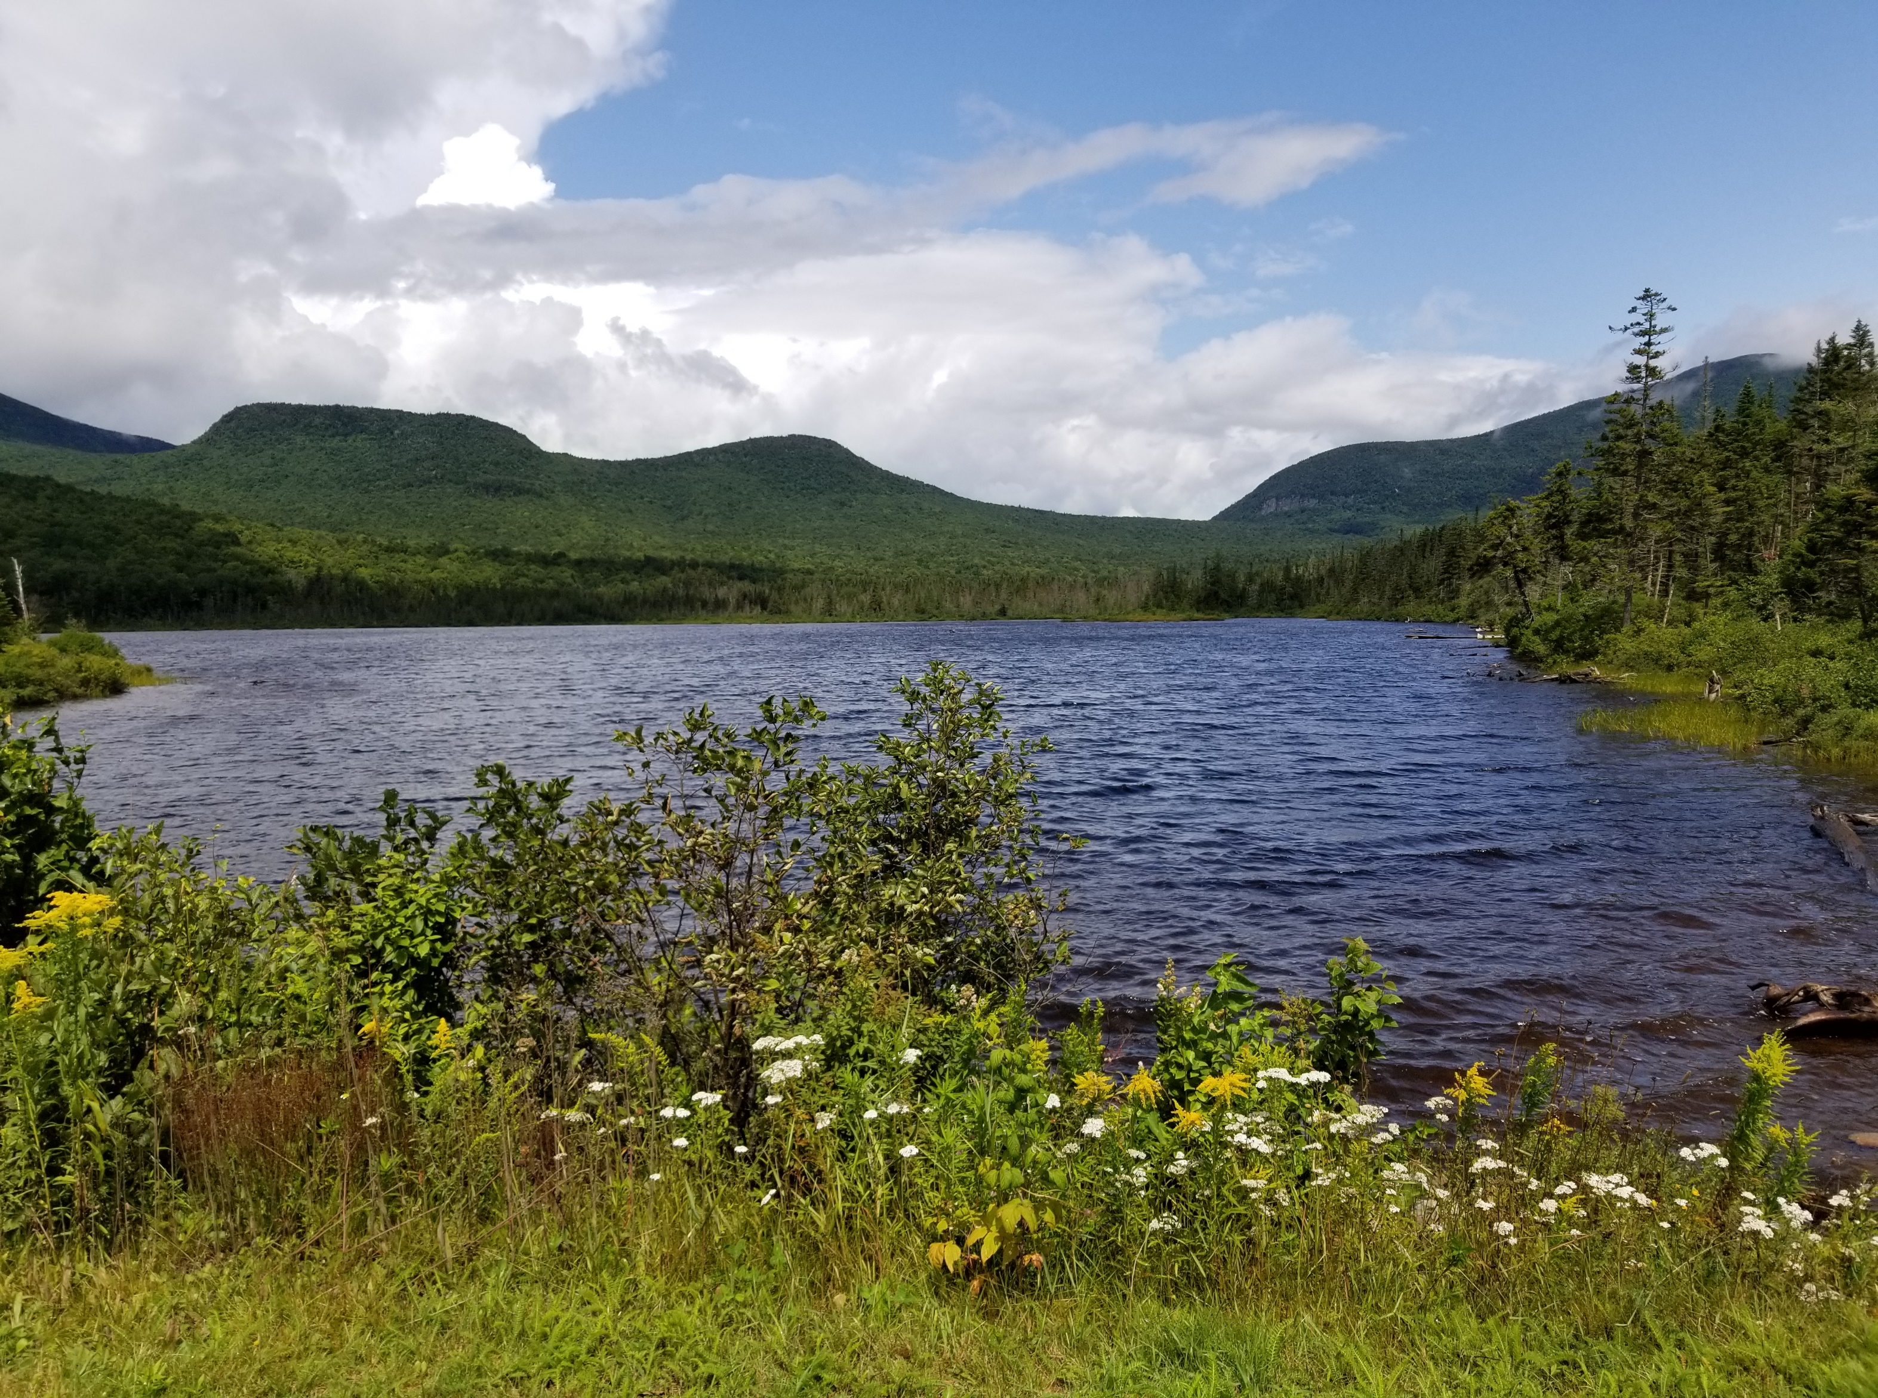
https://www.nbrc.gov/NEPA
NEPA
&
INTAKE and RECORD OF ENVIRONMENTAL CONSIDERATION FORM
OVERVIEW
October 2026

Slide 2

NATIONAL ENVIRONMENTAL POLICY ACT (NEPA)
SESSION OBJECTIVES:
What is NEPA?
NEPA applies to NBRC funded projects
What is National Historic Preservation Act Section 106?
Section 106 (federal review) also applies to NBRC funded projects
Review of NEPA Intake Form
  Comprehensive Document to assist NBRC in making a NEPA determination should the project be funded
  Requires Application Support Documentation
  Not to be confused with the regulatory permitting process – existing permits or the permit application process is not NEPA review!
  Is intended to gather information about a project – it is not intended to make you a NEPA or Section 106 analyst or expert!
NEPA Resources
Presenters: Andrea Smith & Shannon Kelly, NBRC

Slide 3
What is NEPA?
National Environmental Policy Act (NEPA) – 1970
Promote the protection, preservation, and enhancement of the environment.
Growing concerns about the environmental impacts of large-scale development projects
Purpose:
Federal agencies must consider the potential impacts of major federal actions and reasonable alternatives on the human environment​​
NEPA Trigger: Major Federal Actions – Activities that are undertaken, funded, authorized, or approved by a federal agency.
NEPA applies to NBRC-funded projects

Slide 4
Understanding NEPA Implementation Across Federal Agencies
Varied Implementation:
  Each federal agency implements NEPA differently based primarily on its mission
2. Agency-Specific Procedures:
Agencies are required to adhere to their own NEPA procedures and guidelines
3. Example: USDA vs. NBRC:
  USDA Experience: A project categorized as a CATEX under USDA regulations
  NBRC Regulations: The same project may not be considered a CATEX under NBRC regulations
4. Unless a formal agreement exists between a federal agency and a state, a state’s review process is not a substitute for federal NEPA review
  NBRC makes the final decision on adoption of another agency’s NEPA review – not the grantee
5. Takeaway:
Experience with NEPA procedures in one agency does not guarantee the same outcomes in another agency

Slide 5
LEVEL OF NEPA ANALYSIS
Level 1: Categorical Exclusion (CATEX)
The project is pre-determined by the federal agency not to have a significant impact on the human environment.
General/Administrative CATEXs: Do not require supporting documentation
  Examples: economic development and infrastructure plans, workforce development, education, training programs, equipment acquisition, installation, and maintenance
Programmatic CATEXs: Require supporting documentation (e.g., floodplain maps, wetland maps, etc.)
Examples: Applies to projects involving substantial construction, renovation, expansion and involves modifications to existing facilities, utility, telecommunication, and transportation infrastructure
Level 2: Environmental Assessment (EA):
The project impact is unknown or does not have a reasonably foreseeable significant effect on the quality of the human environment.
Level 3: Environmental Impact Statement (EIS):
The project has a reasonably foreseeable significant effect on the quality of the human environment.

Slide 6
What is National Historic Preservation Act of 1966
Section 106?
Mandates that federal agencies or federally-assisted projects consider the effects of what is referred to as an undertaking on historic properties
  Examples are buildings, structures, districts, objects, and landscapes – not absolute but 50 years in age is a benchmark (45 years in NH)
  Includes land disturbing activities which may unearth items of archaeological significance - previously disturbed land may preclude review, but some states are particular regarding self-directed application of this standard
  Section 106 consultation required with State Historic Preservation Offices (SHPO) and/or Tribal Historic Preservation Offices (THPO)
  SHPO and THPO have 30 days for review
  Information from the grantee and participation is key to moving Section 106 forward

Slide 7
NATIONAL ENVIRONMENTAL POLICY ACT (NEPA)
Navigate to NEPA Intake & REC Form
Keep the NEPA Intake & REC Document open while you review the next slides which will walk you through completion of the form.

Slide 8
SECTION I – PROPONENT INFORMATION
Basic information and supporting documentation is key – applicants are the ones
most knowledgeable about the project!
Project location cannot be overemphasized… analysis on the wrong location
translates to wasted time!
NEPA POC – this person must remain engaged and accessible after grant award!
Blue hyperlinks are provided to assist in retrieving information and/or
supporting documentation from open-source websites

Slide 9
SECTION II – DESCRIPTION OF PROPOSED ACTION AND ALTERNATIVES
Description of Proposed Action - Provide sufficient details for proper evaluation of the proposed action ONLY for the NBRC-funded portion of the project
Purpose & Need for Proposed Action - Describe the relationship between the current and desired future conditions and why Agency financial assistance is needed
Alternatives - Other alternatives considered
No Action Alternative – Outcomes if not funded

Slide 10
SECTION II – DESCRIPTION OF PROPOSED ACTION AND ALTERNATIVES (Cont.)
Administrative or General Categorical Exclusions (CATEX) Review
Does your project fit within NBRC CATEXs 1-3, Denali Regional Commission CATEXs A1-A8, or USFS 36 CFR 220.6(d) (5) CATEX found in Appendix B?
  If so, Your analysis is complete and your project does not require additional NEPA review
If no Administrative or General CATEX applies
  Carefully review Appendix B to screen eligibility first for NBRC CATEXs 4-8, second for Denali Regional Commission CATEXs B1-B7, or third United States Forest Service CATEXs under 36 CFR 220.6(e)
An Environmental Assessment is likely required when a Categorical Exclusion cannot be applied and/or an Extraordinary Circumstance exists that cannot be mitigated
STOP

Slide 11
SECTION II – DESCRIPTION OF PROPOSED ACTION AND ALTERNATIVES (Cont.)
Screening criteria applicable to NBRC CATEXs 4-8
Urbanized or Previously Developed Areas:
Infrastructure and associated sitework must either be located in designated “urbanized areas,” as defined by the Census Bureau, OR be on land that has been previously developed. Previously developed areas are those where historical grading, landscaping, or existing infrastructure has been established.

Slide 12
SECTION II – DESCRIPTION OF PROPOSED ACTION AND ALTERNATIVES (Cont.)
Screening criteria applicable to NBRC CATEXs 4, 5, and 8
Capacity Consideration:
The future use of the facility will not result in an increase in occupancy that exceeds the capacity of the existing surrounding infrastructure and resources, including sewer, water, energy, roads, and parking.

Slide 13
SECTION II – DESCRIPTION OF PROPOSED ACTION AND ALTERNATIVES (Cont.)
Specific screening criteria applicable to NBRC CATEXs 5, 6, 7, and 8
NBRC CATEX 5—New Facilities: For a proposed new facility to qualify for Categorical Exclusion, is the project area less than two acres of surface land area and the building square footage less than 20,000 square feet?
NBRC CATEX 6—Modifications to Existing Utility Infrastructure: Limitations on wells - Are newly proposed wells connecting to an existing water system? The installation of new wells is not permitted in areas with existing or reasonably foreseeable water shortages.
NBRC CATEX 7—Modifications to Existing Telecommunications Infrastructure - For projects involving towers, will the total height exceed 200 feet?
NBRC CATEX 8—Modifications to Existing Transportation Infrastructure - Does / Do the addition(s) to transportation infrastructure integrate with the existing transportation network?
Exclusions: This CATEX prohibits projects resulting in a change to the mode of transportation e.g., a bike path that is expanded to ATV use. Excludes water-related infrastructure projects, including ports, harbors, docks, and related facilities.

Slide 14
SECTION III – ADDITIONAL PROJECT INFORMATION
Project implementation timeline important to determine potential impacts (Example: Threatened and Endangered species maternity roosting season)
Other federal funders – important for lead agency designation, environmental coordination, and potential NEPA adoptions
State funders – potential use of environmental documentation; NEPA adoption if a state has prior written agreements with another federal agency
NEPA process currently underway – important for potential NEPA adoptions

Slide 15
SECTION III – ADDITIONAL PROJECT INFORMATION
Is this project dependent on the completion of another project and/or are there any other projects that cannot move forward without the completion of this project?
NEPA reviews must consider connected actions (completion of one depends on another) even if NBRC is not funding the other action (Example: A building constructed by another Agency is necessary for a roof-mounted solar array we are funding)
Has any public outreach or engagement work been done for this project?
Important for situational awareness of public knowledge about the project
Is there any known or anticipated public controversy that would result from the implementation of the project activities (i.e., a public dispute over the proposed land use)?
Anticipation of public opposition is helpful!

Slide 16
SECTION IV – ENVIRONMENTAL REVIEW LEVEL OF DETERMINATION
Do any of the following Extraordinary Circumstances exist?
(a) Health and Safety: The action has the potential to significantly adversely affect public health and safety.
(b) Hazardous Materials: The action involves the use, transportation, distribution, storage, or disposal of hazardous substances, pollutants, contaminants, or petroleum and natural gas products in a manner that may result in significant environmental effects.
(c) Noise: The action has the potential to generate excessive or prolonged noise levels that may adversely impact sensitive noise receptors and disrupt quiet environments, such as natural habitats or recreational areas, leading to disturbances in wildlife behavior or recreational activities.
(d) Regulatory Compliance: The action has the potential to violate federal, state, Tribal, or local laws or other requirements, or be inconsistent with federal, state, Tribal, or local policies for the human environment.
(e) Historic and Cultural Resources: The action has the potential to significantly adversely affect historic or cultural properties, sites, or resources, including those listed on national or state registers, or those eligible for such designation.
(f) Environmental Resources: The action has the potential to significantly adversely affect environmental resources, including, but not limited to, species listed or proposed to be listed under the Endangered Species Act, designated critical habitat, wetlands, floodplains, federally protected waters, and prime or unique farmland.
(g) Unique Risk/Uncertainty: The action involves uncertain risks, impacts, or scientifically controversial factors that may affect the human environment.
(h) Precedent Setting: The action establishes a precedent for future actions with the potential for significant environmental effects.
(i) Scientific Controversy: The action has the potential to generate scientific controversy related to the environmental effects of the proposed action.
(j) Scope and Size: The circumstances may arise in which usually categorically excluded actions may have a significant environmental impact and, therefore, may generate a requirement for further environmental analysis. Examples of situations where such unique circumstances may be present include actions of greater scope or size than generally experienced for a particular category of action.

Slide 17
SECTION V – ANALYSIS
Environmental Analysis & Supporting Documentation for a Categorical Exclusion
Land ownership, zoning, parcel numbers, existing leases, easements, and rights-of-way are important ownership patterns that may have implications on environmental impacts or requirements - especially local ones
Land or structure acquisition – liability protection from undetected contamination is important under the All-Appropriate Inquiries rule – Phase I Environmental Site Assessments provide protection
Maps (project, topographic, aerial) & Design Plans – Important on a basic level to understand potential project-level impacts
Ground level photos (exterior and interior) – Current photos paint the most accurate picture

Slide 18
SECTION V – ANALYSIS
Environmental Analysis & Supporting Documentation for a Categorical Exclusion
Total square footage of proposed land disturbance – Importance can relate to eligibility for a CATEX or need for a stormwater permit as two examples
Total square footage of existing or proposed structure(s) (if applicable) – Similar to land disturbance, importance can relate to eligibility for a CATEX
Total impervious surface (square footage / acreage) - Can trigger a need for a stormwater permit
Linear distance(s) in feet – Linear distance gives a sense of potential for environmental impacts; greater the distance the greater the likelihood something will cross wetlands, streams, etc.
Excavation depths – Deeper the excavation – particularly in areas with known archaeological resources – the greater the likelihood of unearthing items of cultural significance

Slide 19
SECTION V – ANALYSIS
Historic & Cultural Resources – NHPA Section 106
Does the project involve work on existing structures?
  If yes, are Historical Properties present? - 50 years is starting point; 45 years in N. Hampshire
If yes, please state if your project involves:
preservation ☐ rehabilitation ☐ restoration ☐ reconstruction ☐ renovation ☐ demolition ☐
  Each term has a specific meaning to a State Historic Preservation Office under Section 106
If land disturbance is proposed as part of your project, are Archaeological sites present?
  Previously disturbed sites are often cited for exclusion, but some states are strict with this
  Deeper the excavation – particularly in areas with known archaeological resources – the greater the likelihood of unearthing items of cultural significance
  Is Tribal consultation with the Tribal Historic Preservation Officer required?
    Consultation with a federally recognized tribe in the project’s state is required

Slide 20
SECTION V – ANALYSIS
Formally Classified Land
Is the project located on any federal, state (ME,NH,NY,VT), municipal, or other type formally classified land such as, but not limited to, parks, wilderness areas, state or national forests, National Scenic Riverways etc.?
  Some projects NBRC commonly funds may take place on U.S. Forest Service land or other formally classified land
  A project on formally classified land is not itself an adverse circumstance, but it signals the need for communication, coordination, and synchronization of efforts

Slide 21
SECTION V – ANALYSIS
Important Farmland
Is Important Farmland directly or indirectly affected by the project including the amount of area disturbance?
  Point of analysis is to verify if we are converting farmland important on a federal or state level
  Exemptions exist for certain types of projects - these should be verified as part of analysis

Slide 22
SECTION V – ANALYSIS
Natural Resources
Will the project affect federal or state threatened, endangered, proposed or candidate species, or designated critical habitat?
  The U.S. Fish and Wildlife Service iPAC (Information and Planning and Consultation) report is the definitive federal source
  Definitive sources are also available in each respective state (ME, NH, NY, VT)
  Will any trees be removed during the project?
  Importance of this question relates to potential impacts to threatened and endangered species such as bats and birds
  Will the project avoid impacts on any bird species identified in the iPAC report that are protected under the Migratory Bird Treaty Act (MBTA) or under the Bald and Golden Eagle Protection Act?
  Refer to the iPAC report and consider how and if your project’s activities will impact any species in the report
  Will the project impact marine critical habitat designated and managed by the NMFS (National Marine Fisheries Service)?
  If your project proposes activities that impact a marine environment, the marine critical habitat mapper and NMFS link provide resources to determine critical habitat designation and other details
  Will the project potentially introduce, spread, or contribute to the continued existence of invasive species?
  Importance of this question relates to potential impacts to threatened and endangered species such as bats and birds

Slide 23
SECTION V – ANALYSIS
Wetlands
Impacts to wetlands and/or water of the United States may constitute an Extraordinary Circumstance, which may require an Environmental Assessment (EA)
  Links to USFWS National Wetland Inventory maps, state-specific maps, and USDA Natural Resource Conservation Service Web Soil Surveys provide authoritative sources for wetlands and hydric soils verification
  Links to resources for U.S. Army Corps of Engineers Clean Water Act Section 404 (wetlands, dredging, and filling), Section 10 (construction in or over navigable waters) and state permitting (Clean Water Act Section 401 certification) are provided to assist in applying for required permits

Slide 24
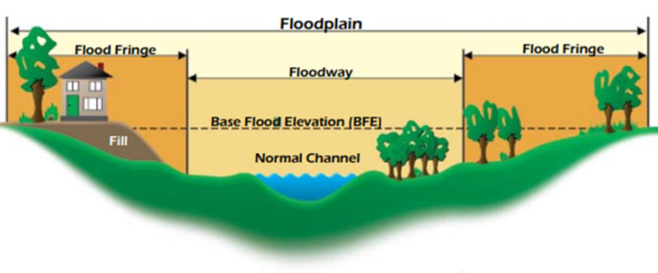
SECTION V – ANALYSIS
Floodplains
Is a 100- or 500-year FEMA (Federal Emergency Management Agency) Flood Zone present)?
  FEMA Floodplain Maps are the definitive source for verification
  A project located in a 100-year or 500-year floodplain requires an 8-step analysis that includes a 15-day public comment period
    A 100-year flood means there is a 1 (one) percent chance a flood of this magnitude occurs annually
    A 500-year flood means there is a 0.2 percent chance a flood of this magnitude occurs annually
  Alternatives must be considered to locate the project outside the floodplain
  Projects in floodways are prohibited!
  Part of the floodplain where water moves fastest and deepest

Slide 25
SECTION V – ANALYSIS
Surface Water Resources
Will construction, land disturbance, or Alteration of Terrain meet or exceed one acre?
  This triggers the need for a state or federal (in the case of New Hampshire) stormwater permit
  New Hampshire has additional state-required stormwater permitting requirements
Will the project discharge stormwater from an industrial facility that requires a stormwater permit often referred to as a Multi-Sector General Permit?
  Examples include facilities such as manufacturing mills or airports
Will the project propose to increase existing or create new impervious surface above state thresholds for a permit?
Impervious surfaces include concrete, asphalt, rooftops, etc. – anything that creates a surface that disallows stormwater infiltration
Will the project propose to increase existing or create new impervious surface above state thresholds for a permit?
Impervious surfaces include concrete, asphalt, rooftops, etc. – anything that creates a surface that disallows stormwater infiltration
  Is your project in a location operating under a Municipal Separate Storm Sewer (MS4) permit?
  Municipalities of a certain population or population density require an MS4 permit that regulates certain activities within its boundary
  Is a wastewater permit required (ME, NH, NY, VT)?
  Septic line expansions, new septic systems, septic upgrades can all require, or potentially require, a permit

Slide 26
SECTION V – ANALYSIS
Groundwater Resources
Is a drinking water permit required?
  Required when establishing new drinking water systems or upgrades to existing water infrastructure
  Is the project located within a Sole Source Aquifer?
  Defined by the USEPA as “…an aquifer that provides at least 50% of the drinking water for the overlying area, and for which no alternative water source is physically, legally, and economically feasible if contamination occurs.”
  USEPA designation is intended to protect critical drinking water supplies from contamination and ensure long-term water security
Is the project located within a Wellhead or Groundwater Protection Area?
  Analysis of state-specific resources aligns with the purpose of a federal review

Slide 27
SECTION V – ANALYSIS
Air Quality
Objective:
1) Determine the project location’s attainment / nonattainment / maintenance status for the USEPA’s six criteria pollutants;
2) Verify state implementation plan status (in non-attainment and maintenance status areas);
3) Identify air quality permits required, if any (may be required regardless of NAAQS compliance status);
4) Determine potential for significant emissions (usually larger scale operations that emit fossil fuels)
  Six National Ambient Air Quality Standards (NAAQS) criteria pollutants
  CO (Carbon Monoxide), Pb (Lead), NO2 (Nitrous oxide), O3 (Ozone), SO2 (Sulfur dioxide), PM10 (Particulate Matter ≤10 µm in diameter), and PM2.5 (Particulate Matter ≤2.5 µm in diameter)
    Pose health risks
Attainment: None of these pollutants exceed the NAAQS limits in that geographic location
Nonattainment: One or more of these pollutants exceed the NAAQS limits in that geographic location
Maintenance: Air pollution control efforts are in place to reduce criteria pollutant exceedances(s) in the geographic location

Slide 28
SECTION V – ANALYSIS
Solid Waste / Hazardous Waste / Hazardous Materials / Aboveground Storage Tanks / Underground Storage Tanks
  Solid Waste / Hazardous Waste / Hazardous Materials
  Primary purpose is to identify generation of solid and/or hazardous waste and use of hazardous materials as part of the project and point to proper management under regulatory requirements
  Aboveground Storage Tanks and Underground Storage Tanks
  Primary purpose is to identify proposed installation of tanks and point to resources that guide permitting, installation, and management once installed

Slide 29
SECTION V – ANALYSIS
Environmental Risk Management
  The environmental condition of the property must be evaluated to obtain certain protections from liability under the federal Comprehensive Environmental Response, Compensation and Liability Act (CERCLA) as an innocent landowner, contiguous property owner, or bona fide prospective purchaser and must be conducted within one (1) year prior to the date of acquisition of the subject property and include elements identified in 40 CFR Part 312.20.
  Seeks to discover existing or previously undetected contamination and applies to:
  Acquisition of real property to include structures and land
  Demolition of existing structures
  Requires a Phase I Environmental Site Assessment (site visit, records review, interviews) and if necessary, a Phase II Environmental Site Assessment (site sampling involved)

Slide 30
SECTION V – ANALYSIS
Coastal Areas
  Is the project located in a Coastal Zone Management Area (CZMA) [New Hampshire; Maine]?
  According to the National Oceanic and Atmospheric Administration the purpose is to provide and enable:
    Environmental protection (e.g., wetland restoration, pollution control)
    Economic development (e.g., sustainable tourism, fisheries)
    Climate change adaptation (e.g., sea level rise planning)
    Conservation (e.g., land and water acquisition for protection)
    National Coastal Zone Management Program (CZMP) is the voluntary federal–state partnership that implements these goals
    Projects located in these Areas must follow established requirements in that location

Slide 31
SECTION V – ANALYSIS
Coastal Areas
  Is the project located in a Coastal Barrier Resource Area (CBRA) [New Hampshire & Maine]?
  According to the U.S. Fish and Wildlife Service, the purpose is to:
    Protect coastal areas from flood damage
    Preserve coastal ecological integrity
    Serve as coastal storm buffers
    Protect inland areas from flooding and erosion
    Provide essential aquatic plant and animal habitats
    Similar to Coastal Zone Management Areas, projects located in these Areas must follow established requirements in that location

Slide 32
SECTION V – ANALYSIS
Noise
  Are there ambient noise generators in the vicinity of the project?
  Major roadways (interstates and state highways)
  Railroads
  Airports
  Are there ambient noise generators in the vicinity of the project?
  Are any adverse noise impacts anticipated from construction and / or operation of the project
  (Sites with a day-night average sound level of 65 decibels & below are acceptable)?
  If adverse noise impacts are anticipated, please provide the distance in miles from sensitive noise receptors (check all that apply):
  Schools ☐ Daycare facilities ☐ Hospitals ☐ Residential neighborhoods ☐
  Are there any state or local noise regulations or ordinances that apply in your project location?

Slide 33
SECTION V – ANALYSIS
Transportation
  Are existing facilities and routes (road, rail, air) adversely impacted by the project?
  Purpose is to identify adverse impacts as part of analysis – disruptions are common sources of public frustration and consideration under review is prudent
  Is there a need for road realignments, signalization, increased delay times or project relocation to avoid adverse impact(s)?
  Are there any transportation studies relevant to the project?
  Not necessary to have – good to provide reference if one exists

Slide 34
SECTION V – ANALYSIS
Visual Impact Assessment
  Are visually sensitive areas or landscape features in the vicinity of the project?
  Viewsheds are important to stakeholders

Slide 35
SECTION V – ANALYSIS
Visual Impact Assessment
  Will the project have disproportionally high and/or adverse effects on minority and/or low-income populations (EJI Explorer Map)?
  Project must consider if the activity and ongoing operation will have adverse or disproportionate impacts

Slide 36
NEPA NBRC RESOURCES
Dedicated NEPA tab on NBRC website https://www.nbrc.gov/content/NEPA
  NEPA Intake Form
  NBRC NEPA Procedures and CATEX list
    Review to better understand the types of projects NBRC can CATEX
  Budgeting for NEPA
    Understanding NEPA costs, where to allocate in your project budget
  NEPA Process Flowchart
NEPA Resources

Slide 37

QUESTIONS: Contact NBRC via admin@nbrc.gov
Warren Falls (Mad River) –Warren, Vermont

